Slide 1

Matias Lin and Dare Hunt – Face Recognition Program

Slide 2
Our goals
Objective: To be able to recognize different faces
Inspiration: We were amazed by the extensive applications of Machine Learning and wanted to discover and explore a well-known area such as face-recognition. We are aiming to understand how it works and be able to reproduce it adding our own touch.
Minimum viable product: A program that identifies one person.
Being able to recognize every SPIS student, mentors and instructors

Slide 3
recognizers
Eigenfaces
FisherFaces
LBPH

Slide 4
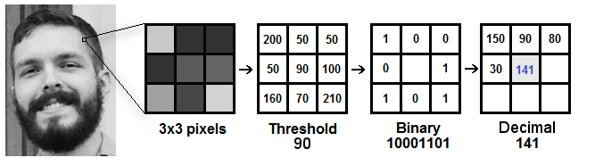
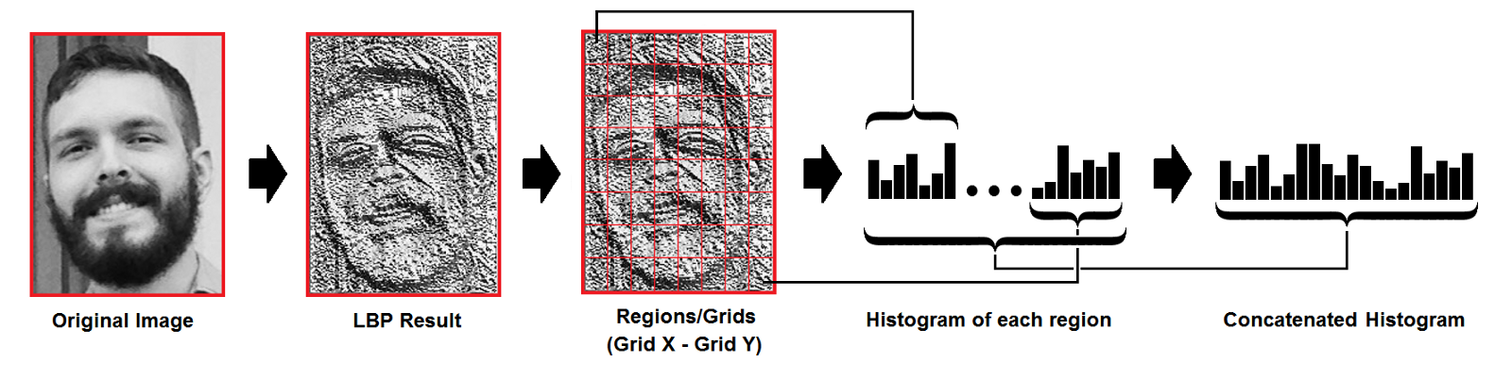
Linear binary pattern histogram (lbph)

Slide 5
Results
SPIS' FACE
# Images | Time to train (s)
40 | 126.7
100 | 530.4
154 | 589.3
Main Result: It can recognize Matias Lin and Dare Hunt
Data set: 20 pictures from each individual
The program is able to increase its data set by its own
Areas to improve in:
It’s not as accurate as we would want it to be
In the future, we would like to increase the individuals being recognized

Slide 6
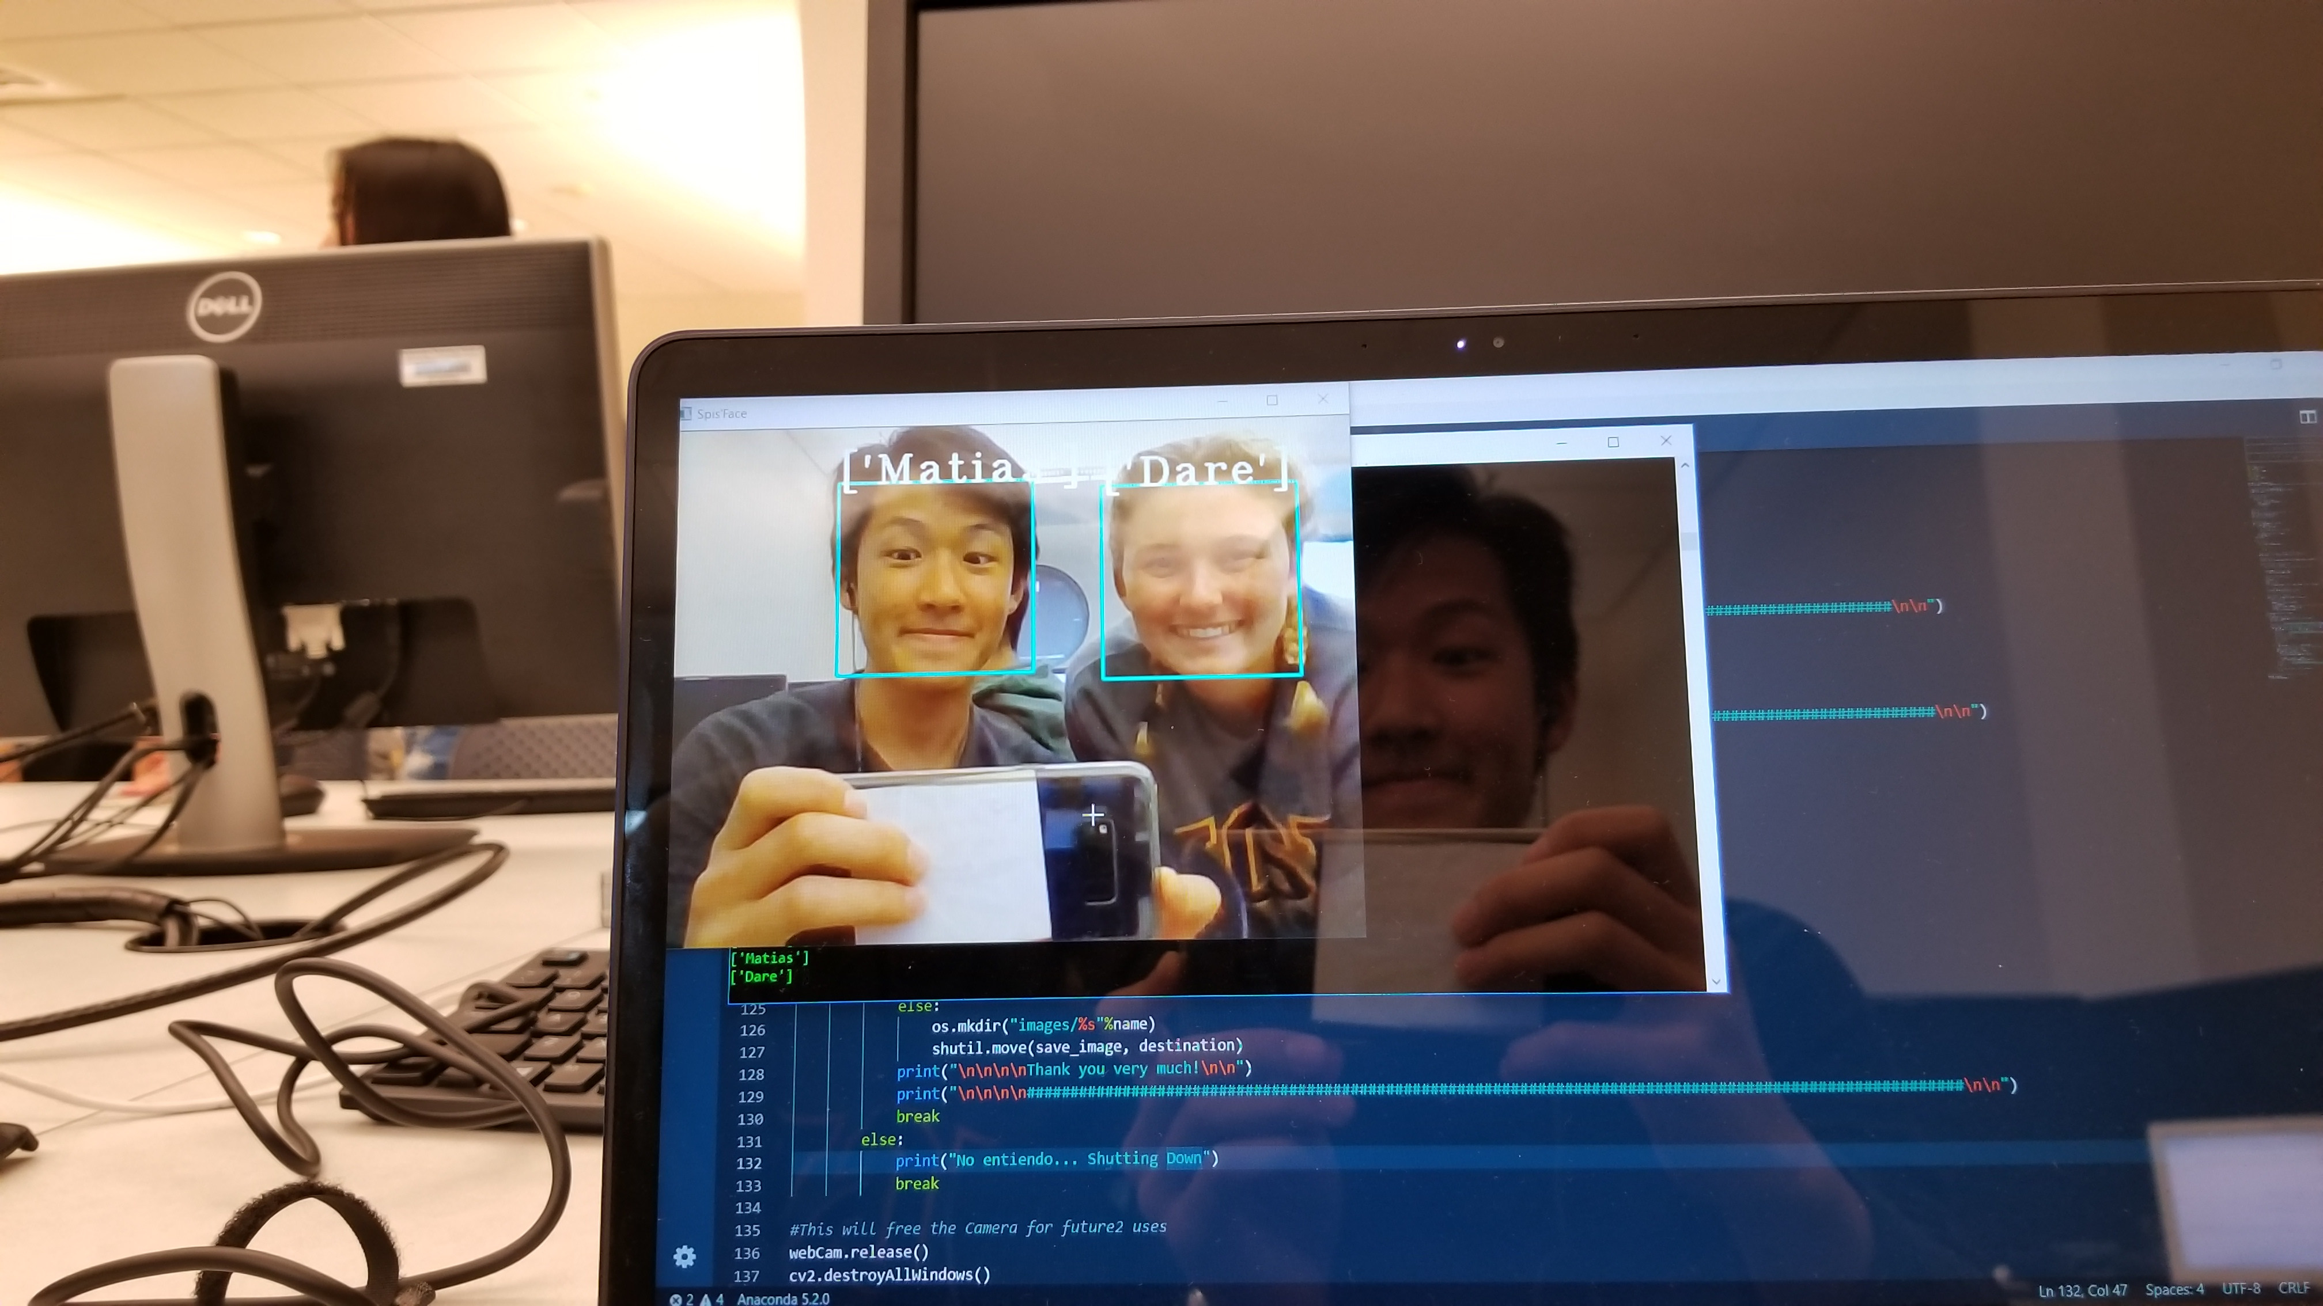
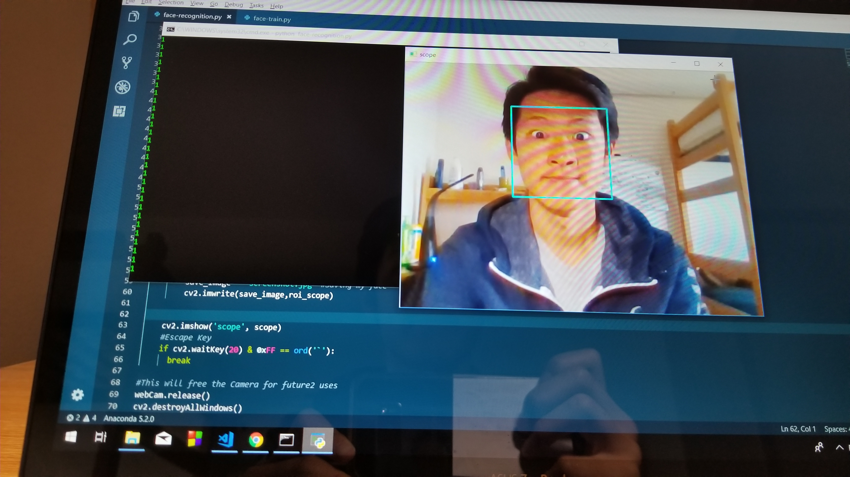
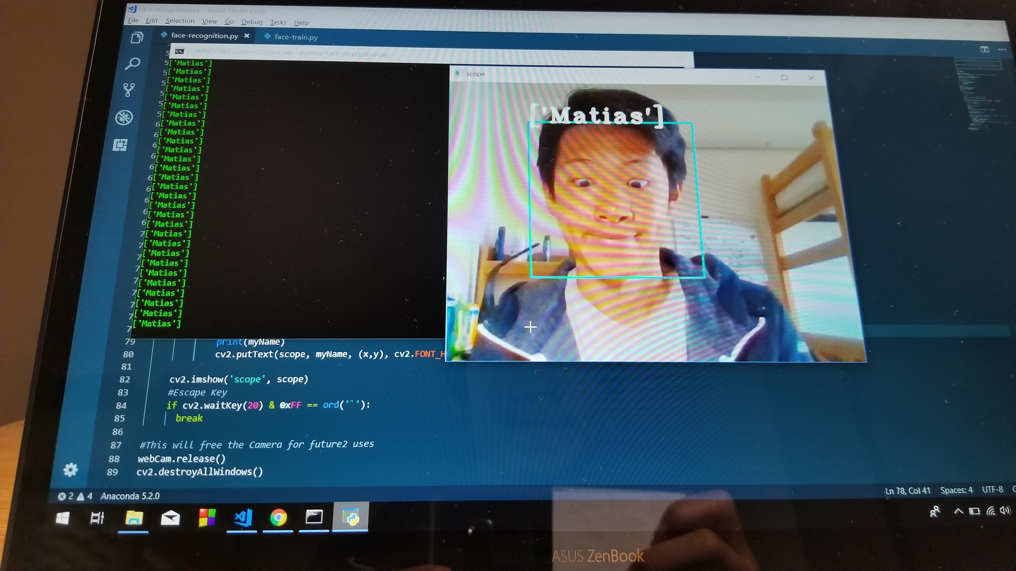
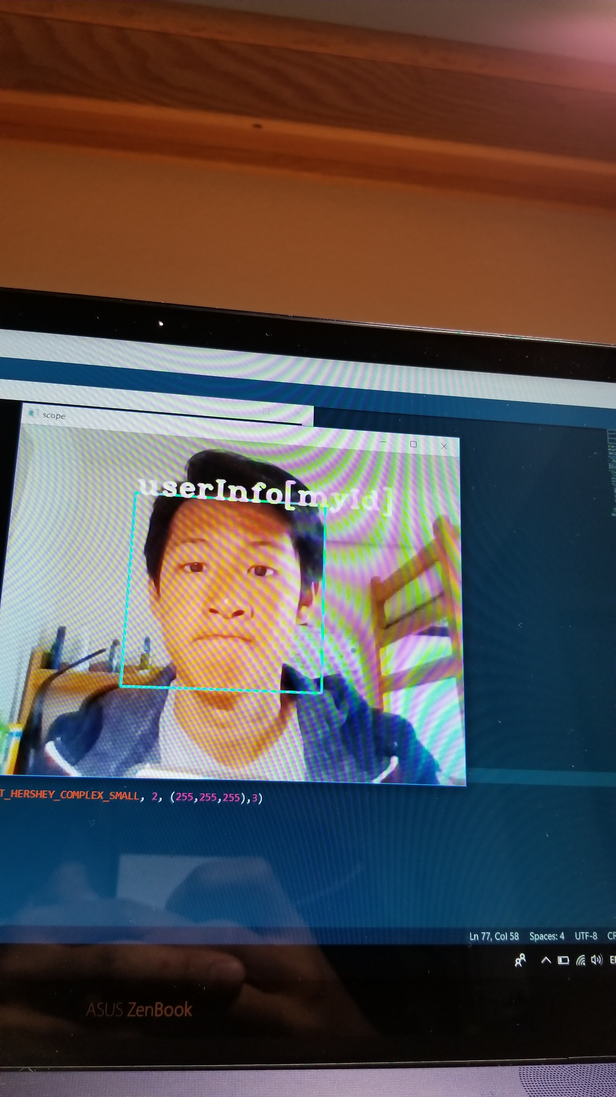
Extra – progress gallery

Slide 7

Sources
Follow this link to a google docs with all of our sources for this project.

